Slide 1
Classification K-Nearest Neighbor
Vera Hollink
2025

Slide 2
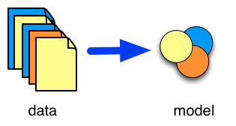
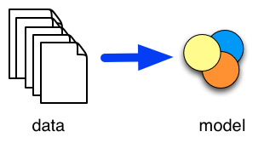
Types of tasks
Supervised
Unsupervised
Classification
Prediction
Associations
Clustering

Slide 3

Famous toy example: iris data set
petal
Petal length
Petal width
Sepal length
Sepal width
Class / species:
iris versicolor
iris virginica
iris setosa
sepal

Slide 4
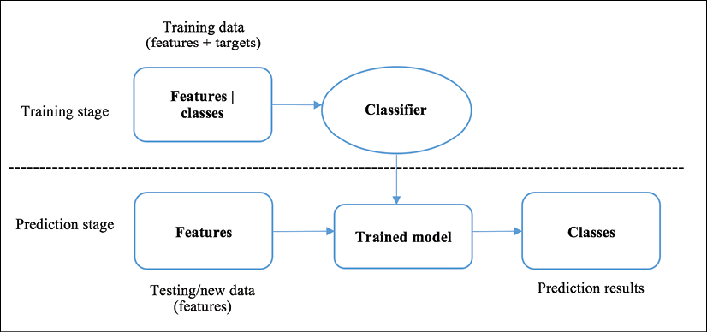
Training and using a classifier

Slide 5
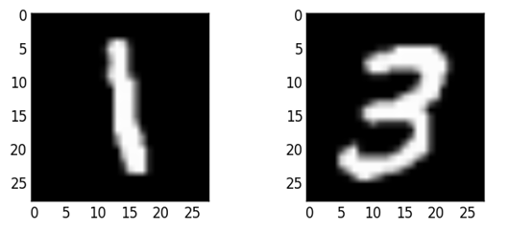
Types of classification
Binary classification
true, false
<30, ≥30
likes movie, dislikes movie
malign, benign
Multiclass/multinominal classification
setosa, virginica, versicolor
Europe, Africa, Asia, North America, South America, Australia+Pacific
Recognize characters

Slide 6
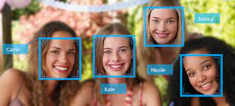
Types of classification
Multilabel classification
Which pets does a person own? Dog, cat, fish, guinea pig, rat
Recognize all people in a picture
Solution?
Split multilabel classification into multiple binary classification tasks
Has_dog
Has_cat
Has_fish
Has_guinea_pig
Has_rat
Shows_Peggy
Shows_Nirajan
Shows_Karima
…

Slide 7

K-Nearest Neighbor classifier

Slide 8
1-nearest neighbor
Database with cases (supervised)
Find case that is closest to new case (neighbor)
Classify new case as neighbor

Slide 9
Example: customers
= Buy
= No buy
age
IIncome

Slide 10
Example: customers
= Buy
= No buy
New customer
age
IIncome

Slide 11
Example: customers
= Buy
= No buy
Nearest neigbor
age
IIncome

Slide 12
Example: customers
= Buy
= No buy
Classify as: Buy
age
IIncome

Slide 13
K-nearest neighbor
Database with cases
Find k cases that are closest to new case (neighbors)
Majority voting: Classify new case as most common class under k neighbors

Slide 14
Example: customers k = 3
= Buy
= No buy
New customer
age
IIncome

Slide 15
Example: customers k = 3
= Buy
= No buy
Neighbors
age
IIncome

Slide 16
Example: customers, k = 3
Neighbors:
class = Buy
class = No buy
class = No buy
No buy: 2 votes
Buy: 1 vote

Slide 17
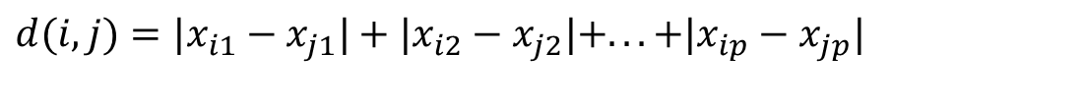
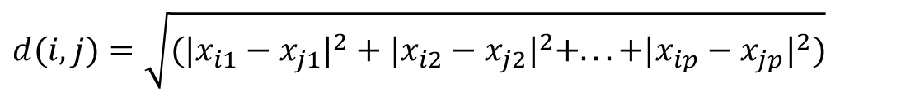
How to measure the distance?
Euclidean distance (numerical features)
Manhattan distance (numerical features)
Hamming distance (nominal features)
$$d(i,j)=\sqrt{(|x_{i1}−x_{j1}|^{2}+|x_{i2}−x_{j2}|^{2}+...+|x_{ip}−x_{jp}|^{2})}$$
$$d(i,j)=|x_{i1}−x_{j1}|+|x_{i2}−x_{j2}|+...+|x_{ip}−x_{jp}|$$
$$d\left(i,j\right)=Dx_{i1}x_{j1}+Dx_{i2}x_{j2}+…+Dx_{ip}x_{jp}$$
$$Dx_{ik}x_{jk}=0 if x_{ik}{=x}_{jk} Dx_{ik}x_{jk}=1 if x_{ik}{≠x}_{jk}$$

Slide 18
Pros and cons of k-nn
Advantages
Clear method, easy to explain
Model extensible with new cases
Numerical and nominal data and combinations
Disadvantages
Inefficient with many cases ➔ lazy learner
Model does not provide insights

Slide 19

K-NN with scikit-learn
# import libraries
import numpy as np
import pandas as pd
from sklearn.neighbors import KNeighborsClassifier
# load data (using pandas)
data_iris = pd.read_csv('C:/Users/…../Data/iris.csv')
X = data_iris[['sepal_length', 'sepal_width', 'petal_length', 'petal_width']]
y = data_iris['species']
# build a k-NN model with k=3
clf = KNeighborsClassifier(n_neighbors=3)
clf.fit(X, y)
# use the model to predict new example
predicted = clf.predict([[4.4, 3.6, 1.7, 0.2]])

Slide 20
And now…
Exercises part 3:
Bullet points 1-3

